Slide 1
RandLA-Net: Efficient Semantic Segmentation of Large-Scale Point Clouds
Qingyong Hu, Bo Yang, Linhai Xie, Stefano Rosa, Yulan Guo, Zhihua Wang, Niki Trigoni, Andrew Markham
CVPR 2020 Oral.
2020-05-15
SKKU Yang Yong Jun
Notes:
Paper: https://arxiv.org/abs/1911.11236
Code: https://github.com/QingyongHu/RandLA-Net
Blog https://zhuanlan.zhihu.com/p/105433460

Slide 2
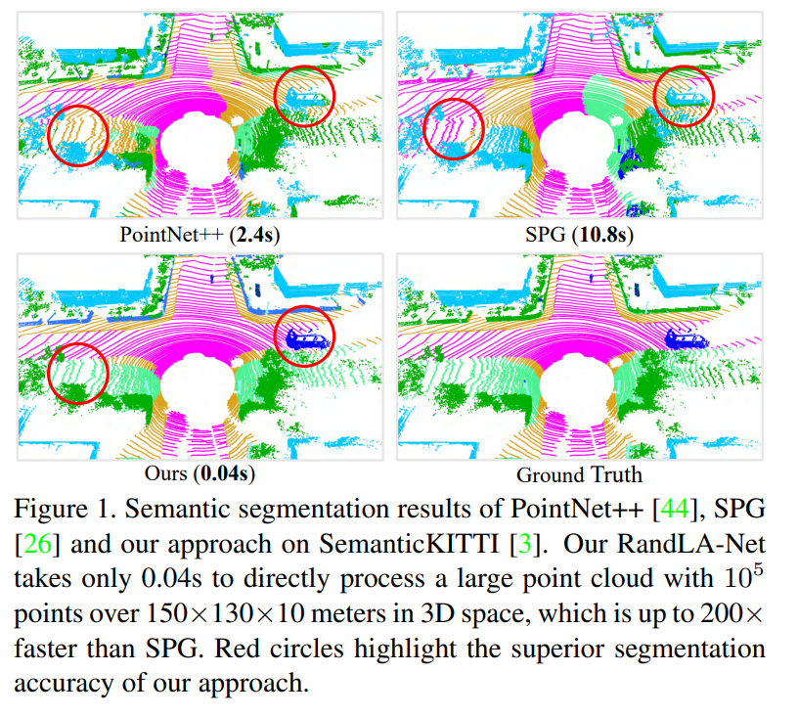
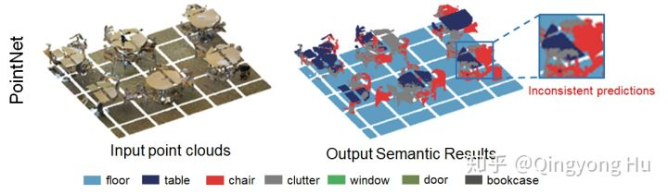
Figure
PointNet approach
You need to cut into small 1m × 1m point cloud blocks, then sample each point cloud block to get a 2048 point input network.
When cutting into zones, the overall shape of the object is lost
Cannot learn shape information of objects larger than the size of the zone

Slide 3
Abstract
Most existing approaches are relying on expensive sampling techniques or computationally heavy pre/post-processing steps
we introduce RandLA-Net, an efficient and lightweight neural architecture to directly infer per-point semantics for large-scale point clouds.
The key to our approach is to use random point sampling instead of more complex point selection approaches.
we introduce a novel local feature aggregation module to progressively increase the receptive field for each 3D point, thereby effectively preserving geometric details.

Slide 4
Introduction
The existing point cloud segmentation approach cannot capture a wide range of context information
Cannot scale from a small point cloud to a wide poitn cloud
Reason
1) Point cloud sampling is computationally expensive or memory inefficient
2) Most local feature learners rely on expensive computational methods
3) In the case of a large-scale point cloud with many objects, existing local learners cannot learn complex structures or have an acceptable size.
Solved
1) Design a memory and computationally efficient deep learning network that can process large-scale poitn clouds without preprocessing of point clouds
2) By gradually increasing the receiving field size of the local layer, you can effectively learn the complex local structure.

Slide 5
Approach & Contribution
Approach
1) For each 3D point, a local spatial structure (LocSE) unit is first introduced to explicitly preserve the local geometry.
2) Utilizes meticulous pooling to automatically maintain useful local functions.
3) Multiple LocSE devices and meticulous pooling are stacked into an extended residual block to significantly increase the effective acceptance field of each point. All of these neural components are implemented as a shared MLP, making them highly memory and computationally efficient.
Contribution
1) We analyze and compare existing sampling approaches, identifying random sampling as the most suitable component for efficient learning on large-scale point clouds.
2) We propose an effective local feature aggregation module to preserve complex local structures by progressively increasing the receptive field for each point.
3) We demonstrate significant memory and computational gains over baselines, and surpass the state-of-the-art semantic segmentation methods on multiple large-scale benchmarks.

Slide 6
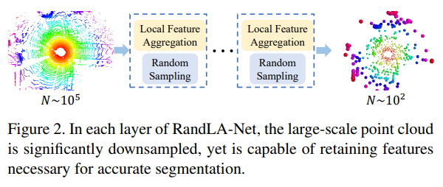
RandLA-Net: Sampling
When processing hundreds of meters of point cloud, you should downsample while maintaining as much geometric information as possible.
-Heuristic sampling
1. Farthest Point Sampling (FPS)
Select the farthest point from the sample
The computational complexity is O(N ^ 2), which makes it unsuitable for large point clouds
2. IDIS (Inverse Density Importance Sampling)
Find the density of the point cloud to make the density of each point uniform
Influenced by outliers
3. Random Sampling
Select K points from the entire point cloud
Select random from uniform distribution
Summary
Many sampling algorithms are computationally expensive or require a lot of memory
Many sampling algorithms are computationally expensive or require a lot of memory
Random sampling is computationally efficient and is independent of the number of input points.
Memory efficiency.
However, random sampling loses a lot of useful information.
Notes:
기존의 point cloud segmentation 접근 방식은 넓은 영역의 컨텍스트 정보를 캡처하지 못한다
작은 point cloud에서 넓은 poitn cloud로의 확장할 수 없다
이유
1) point cloud sampling이 계산적으로 비싸거나 메모리 비효율적이다
2) 대부분 local feature learner는 계산 비용이 많이 드는 방식에 의존한다
3) 많은 객체가 포한된 대규모 point cloud는 기존의 local learner가 복잡한 구조를 학습할 수 없거나 수용 가능한 크기가 정해져 있다
해결한점
1) point cloud의 사전 처리 없이 대규모 poitn cloud를 처리할 수 있는 메모리 및 계산 효율적인 딥러닝 네트워크 설계
2) 로컬 레이어의 수용 필드 크기를 점진적으로 증가시켜 복잡한 로컬 구조를 효과적으로 학습 할 수 있습니다.
샘플링 접근 방법
1) 각 3D 포인트에 대해 먼저 로컬 공간 구조 (LocSE) 단위를 도입하여 로컬 기하학적 구조를 명시 적으로 보존합니다.
2) 세심한 풀링을 활용하여 유용한 로컬 기능을 자동으로 유지합니다.
3) 여러 LocSE 장치와 세심한 풀링을 확장 된 잔차 블록으로 쌓아 각 포인트의 유효 수용 필드를 크게 늘립니다. 이러한 모든 신경 구성 요소는 공유 MLP로 구현되므로 메모리와 계산 효율성이 뛰어납니다.
컨트리뷰션
1) We analyse and compare existing sampling approaches, identifying random sampling as the most suitable component for efficient learning on large-scale point clouds.
2) We propose an effective local feature aggregation module to preserve complex local structures by progressively increasing the receptive field for each point.
3) We demonstrate significant memory and computational gains over baselines, and surpass the state-of-the-art semantic segmentation methods on multiple large-scale benchmarks.

Slide 7
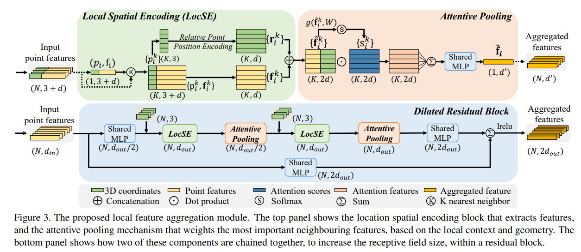
Local Feature Aggregation module

Slide 8
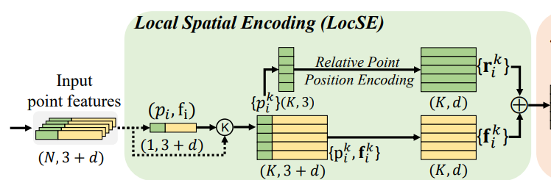
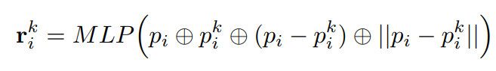
Local Spatial Encoding
Given Point cloud P (x-y-z + R,G,B or learnt feature)
LocSE can observe the local geometric patterns, thus eventually benefiting the entire network to effectively learn complex local structures.
LocSE tends to aid the network to learn local features and obtains good performance in practice
Finding Neighbouring Points – KNN algorithm
Find p_{i} ’s nearst k point, K = {p_{i}¹, p_{i}², … p_{i}^{k}}
Relative Point Position Encoding
⊕ is concatenation operation, || x || is Euclidean Distance

Slide 9
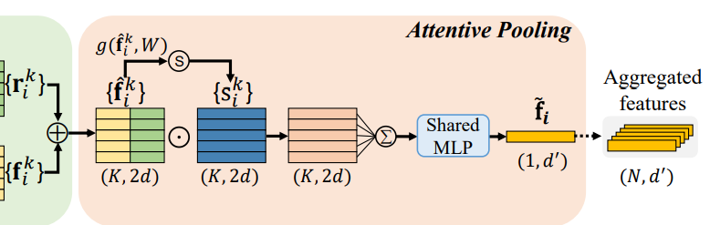
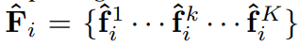
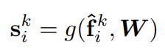
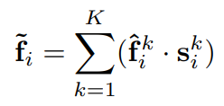
Attentive Pooling
Pointnet typically use max pooling to integrate the local features, information being lost.
Computing attention scores - Function g learns a unique attention score for each feature (score: 0 ~ 1)
Weighted Summation - Network learn selection of important feature automatically
- LocSE & Attentive Pooling learn to aggregate the geometric patterns and features of its K nearest points, and finally generate an informative feature

Slide 10
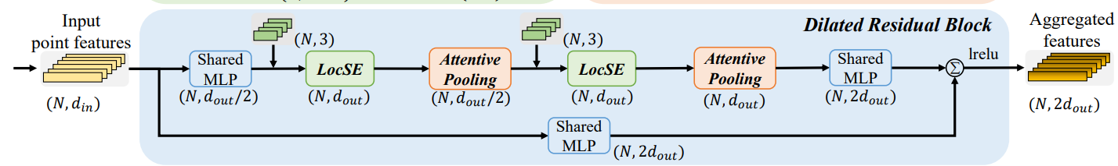
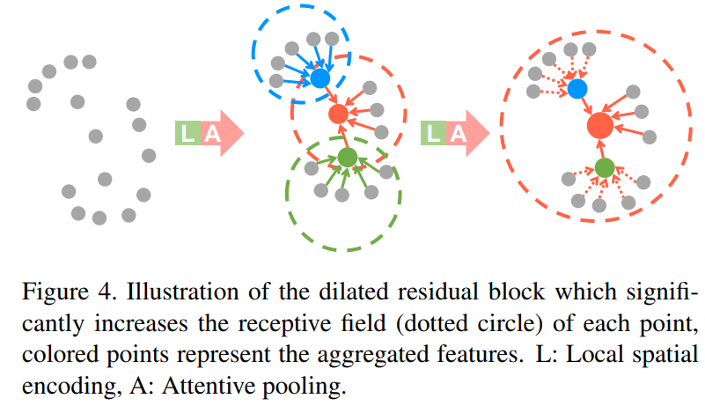
Dilated Residual Block
Since the large point clouds are going to be substantially downsampled, receptive field for each point are increased, geometric details of input point clouds are more likely to be reserved
EX) red point is able to receive information from up to K2 neighbouring points

Slide 11
Local Feature Aggregation module
Local Feature Aggregation module is designed to effectively preserve complex local structures considering neighbouring geometries and significantly increasing receptive fields.
Moreover, this module only consists of feed-forward MLPs, thus being computationally efficient.

Slide 12
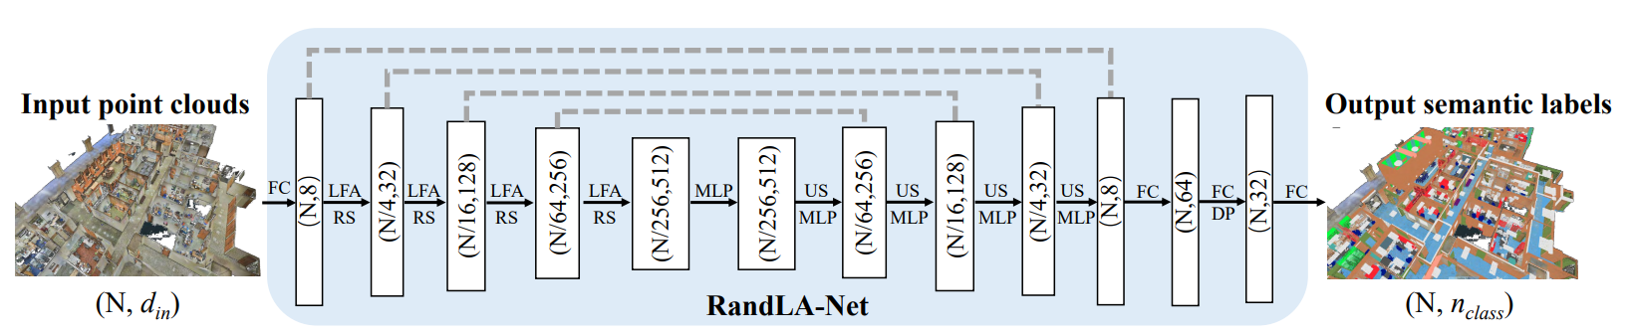
Segmentation Network
MLP: Shared Multi Layer Perceptron FC: Fully Connected Layer, LFA: Local Feature Aggrestion, RS: Random Sampling, US: Upsampling, DP: Dropout
The network follows the widely-used encoder-decoder architecture with skip connections. Shared MLP per points. Predict point label
Input: N x d_{in} (x-y-z, r-g-b)
Encoding Layer: LFA, RS
Decoding Layer: US: Find KNN point & interpolation, Skip Connection
Segmentation Prediction: shared fully-connected layers (N, n_{class})

Slide 13
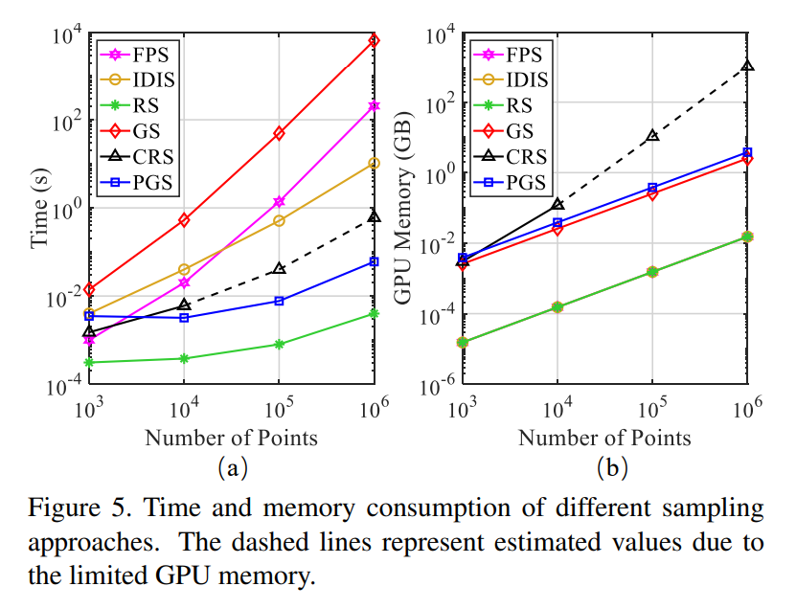
Experiments - Sampling
For largescale point clouds, another method use extremely time-consuming or memory-costly
rely on the expensive sampling approaches

Slide 14
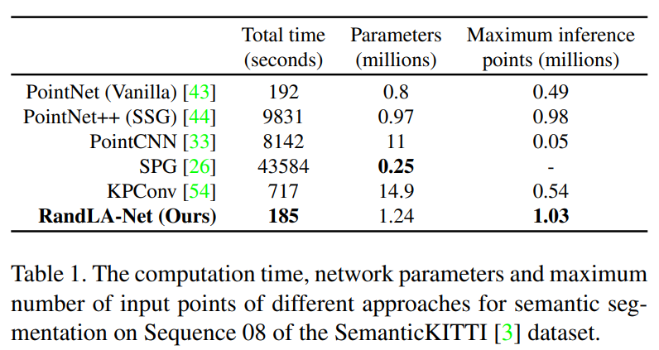
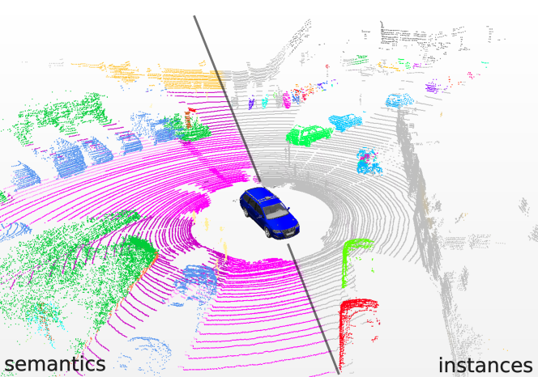
Experiments - Efficiency
Data: 4071 LIDAR scan
Eval time consumption & Network size
Feed Point cloud (size: 81920)
RandLA-Net: 22FPS

Slide 15
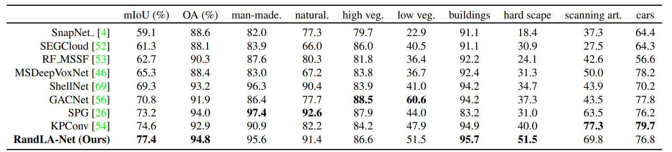
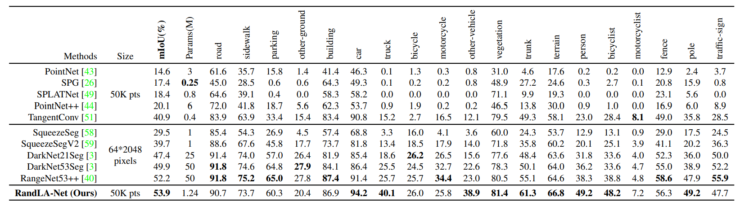
Experiments - Sementation

Slide 17
Conclusion
paper demonstrated that it is possible to efficiently and effectively segment large-scale point clouds by using a lightweight network architecture.
Using Random Sampling
local feature aggregation module is also introduced to effectively preserve useful features from a wide neighbourhood.

